Slide 1
The Gold Rush

Slide 2
Central Historical Question:
How did the Gold Rush affect San Francisco?

Slide 3
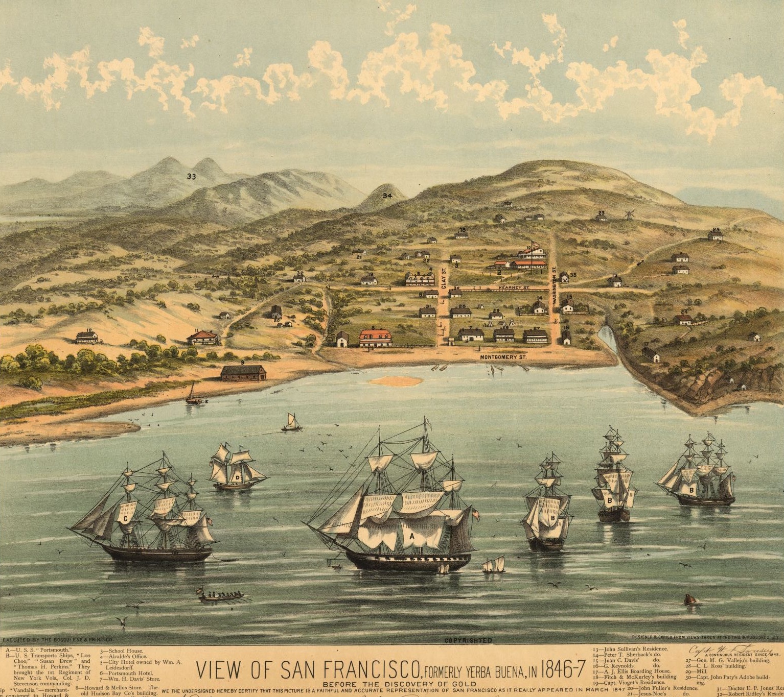
“View of San Francisco in 1846-1847 before the Discovery of Gold”
Artist: Bosqui Eng. & Print Company
Date created: 1884 (designed and copied from views taken at the time).
Notes:
Image retrieved from the Library of Congress at https://www.loc.gov/item/74693207/

Slide 4
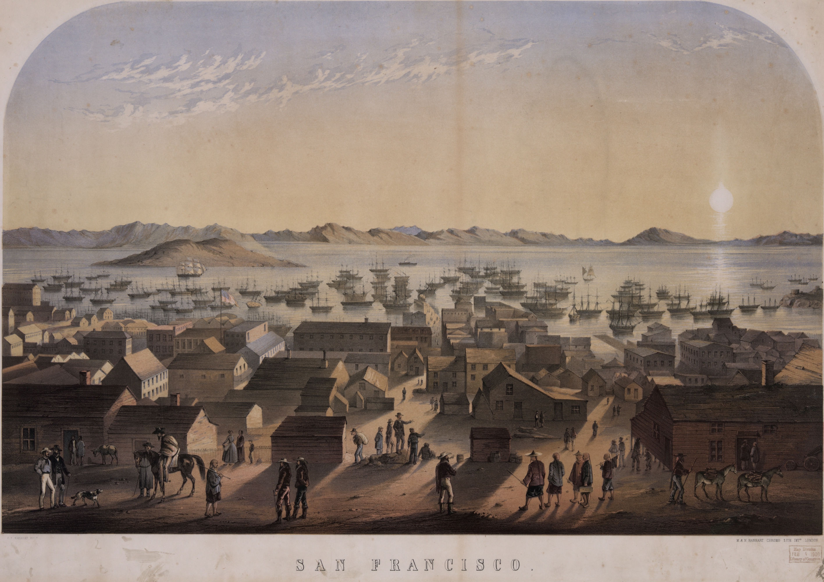
“San Francisco”
Artist: Frank Marryat
Date created: 1850
Notes:
Image retrieved from the Library of Congress at https://www.loc.gov/item/92522389/

Slide 5
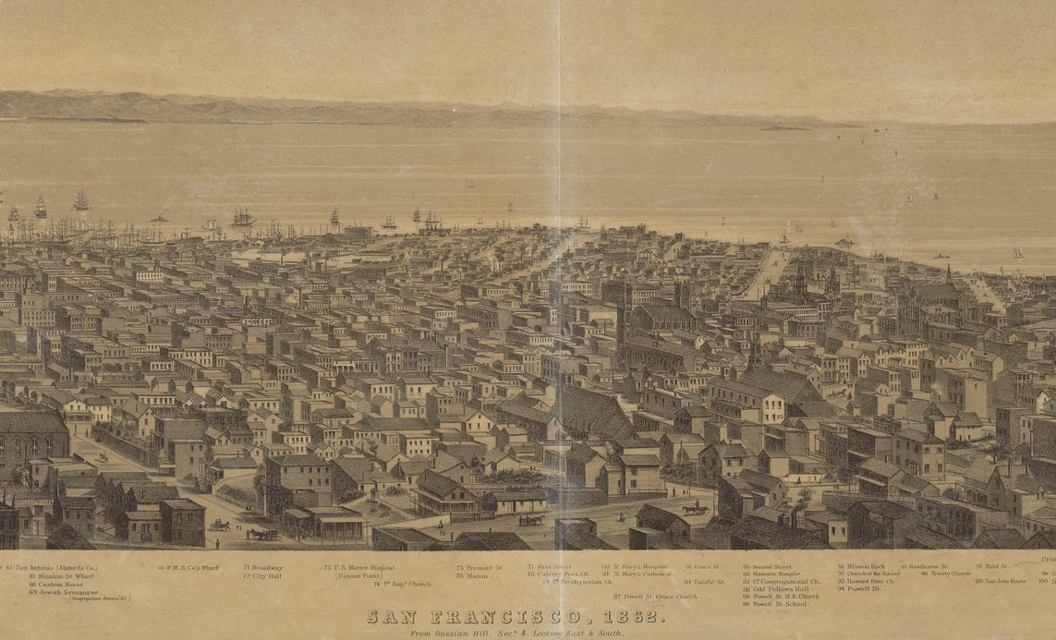
“San Francisco, 1862, from Russian Hill”
Artist: C.B. Gifford
Date created: 1862
Notes:
Image retrieved from the Library of Congress at https://www.loc.gov/item/96505333/

